Slide 1
Waveforms & effective values of Alternating Current & Voltages
Dr. Michael Adeleye

Slide 2
Learning Objectives
To know what is meant by alternating current.
To know how to calculate the rms value of an alternating current.
To know how to calculate the power supplied by an alternating current.

Slide 3
Warm up
What is electric current?
What is the difference between an alternating current and a direct current?

Slide 4

Simulations
Using the embedded PhET simulation (Tab 4 - Transformers) to explore
Differences between a.c. and d.c. by changing the emf source of the Electromagnet from d.c. to a.c.
Effect of changing peak current on the waveform for a.c.
Effect of changing the frequency on the waveform for a.c.

Slide 5
Definition
An alternating current (ac) is a current that repeatedly reverses its direction.
or
A current that changes its direction and magnitude periodically with time.
Direct current (dc) – A unidirectional current that flows from a region of higher to lower potential.

Slide 6
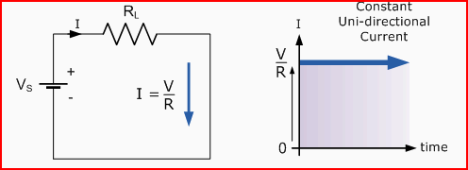
D.C. Circuit & Waveform
A DC voltage and current has a fixed magnitude (amplitude) and a definite direction associated with it.

Slide 7
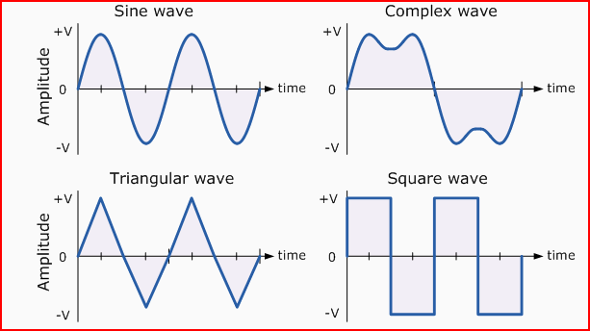
A.C. Waveforms
The shape obtained by plotting the instantaneous ordinate values of either voltage or current against time is called an AC Waveform.

Slide 8
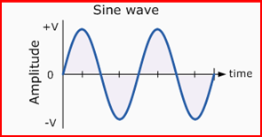
A.C. Waveforms
We focus on the most common form of all a.c. waveforms – sinusoidal
defined by A(t) = A_{max}sin(2πƒt).
Sinusoidal AC/voltage varies periodically with time in magnitude and direction.

Slide 9
Questions
What is frequency? What is the unit of frequency?
What is the frequency & voltage of mains electricity? (British vs American system)
What is the period of domestic mains voltage supply we use in our homes?
Notes:
British – 50Hz, 220V; American – 60Hz, 110V

Slide 10
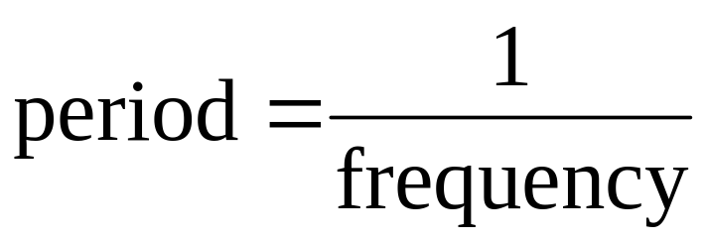
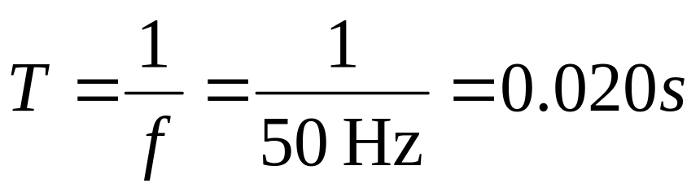
Answers
Frequency is the number of cycles (completed) per second.
The unit of frequency is the hertz (Hz)
Mains electricity is an alternating current with a frequency of 50 Hz → too fast to notice flickering.

Slide 11
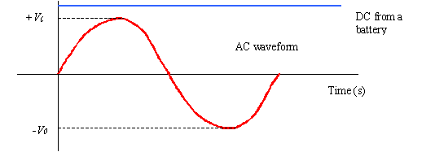
Peak Value
The peak value of an alternating current (or pd) is the maximum current (or pd) which is the same in either direction.
One complete alternation is called a cycle (NOT wavelength).
The graph is called a sinusoidal waveform or a sine wave.

Slide 12
Dealing with a.c.
Note in a.c.
The peak current depends on the peak pd and the components in circuit.
Previous circuit theories apply, but the issues are generally much more complicated.

Slide 13
Example
If the peak pd was 260 V and the resistance of the components in the circuit is 55 Ω, what would the peak current be?

Slide 14
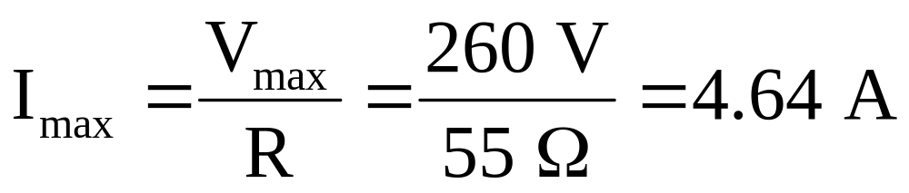
Peak Current
If the peak pd was 260 V and the resistance of the components in the circuit is 55 Ω, what would the peak current be?

Slide 15
Observing AC
An oscilloscope can be used to display the waveform of the alternating pd from a signal generator. → Demo?
What effect does increasing the output pd have?
What effect does increasing the frequency have?

Slide 16
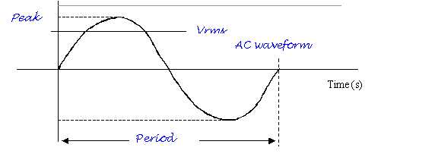
These features are shown on the graph:

Slide 17
Dilemma
An alternating current varies sinusoidally
Its simple mathematical average value over a cycle is zero
BUT it is a known fact that its effect is not zero.
Then what representative value can we assign to this varying quantity?
What is the way out of this conundrum?

Slide 18
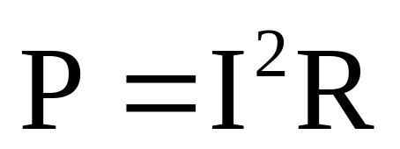
The heating effect of AC
Imagine a heater connected to an ac supply.
It would repeatedly heat up then cool down.
The power, P, supplied to a heater of resistance R:-
Recall that direction of the current doesn’t matter so the power supplied varies with the square of the current.
Notes:
Recall Joules heating effect is irreversible.

Slide 19
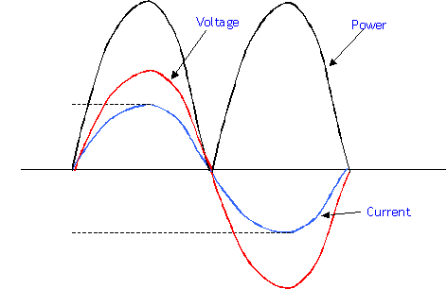
Heating Effect of AC
When I is at its maximum, I₀, max. power is supplied.
When I is zero, zero power is supplied.
The mean power supplied - The mean power dissipated by a resistive load is half the maximum power for a sinusoidal AC.

Slide 20
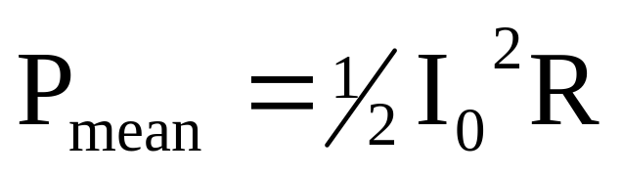
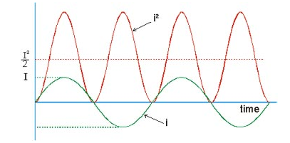
Heating Effect of AC
mean power = (mean value of I²)R
This is from the symmetrical shape of the power curve.

Slide 21
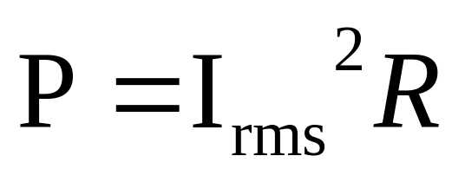
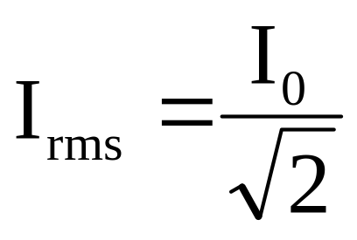
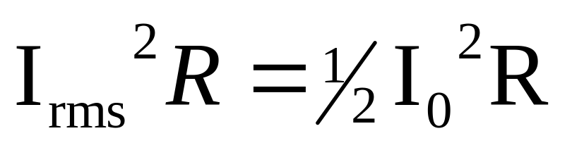
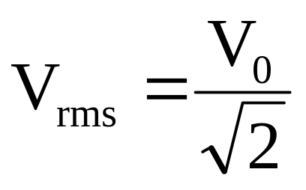
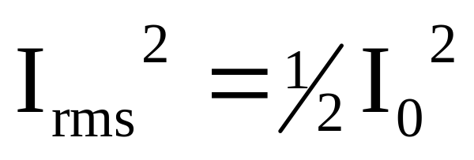
Root Mean Square Value
The root mean square value (rating) of an alternating current is the value of the steady direct current which would dissipate heat at the same rate in a given resistance as the alternating current.

Slide 22
Question 1
What is the rms voltage of an ac mains with a peak voltage of 325 V?
What would be the power supplied to a 70 ohm resistor?

Slide 23
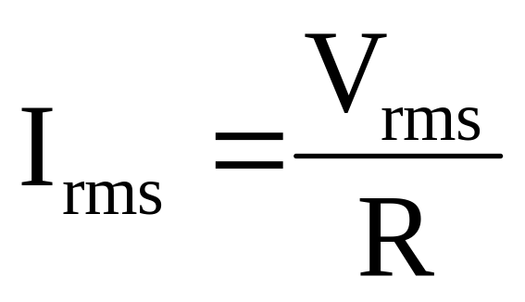
Answer
Vrms = 325/√2 = 230 V
P = (230/70)² x 70

Slide 24
Root Mean Square Value
The values of voltage and current are constantly changing in AC, unlike in DC in which they are steady. We can measure AC voltages in two ways:-
Measure the peak to peak voltage, easily done on a cathode ray oscilloscope (CRO).
Measure the root mean square (rms) value, or the effective value.
We use the rms value because its use allows us to do electrical calculations as if they were direct currents.

Slide 25
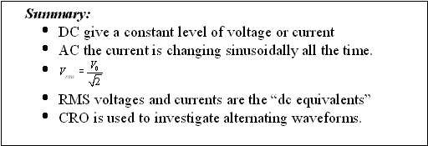
Recap

Slide 26
Question 2
In the previous topic “National grid & high tension power transmission”, we saw the scientific and economic advantages of generating, transmitting & distributing a.c.
Are there any disadvantages of using alternating current (rather than direct current) in the home?
If yes, what are they?

Slide 27
Answer 2
Increased insulation needed for the mains cable, since the peak value of a.c. is higher than its equivalent d.c. (r.m.s. value rating) for the same power supply.
Needs rectification since most domestic appliances uses d.c. not a.c.

Slide 28

Note - Capacitor cannot conduct direct current
    In RC circuit. In the limit of f = 0 (constant voltage), only transient dc current can flow while the capacitor is charging. After being fully charged capacitor cannot conduct direct current but it can conduct alternating current.

Slide 29
Credits
Dr Poulton and Mr Moore
Ranelagh A level Physics Wikispace

